Slide 1
Donald Norman
Design of Everyday things

Slide 2
What is the Human Experience?
Sensation and Perception
Sensory Processes: How we receive stimuli
Interpretation: How we make sense of these stimuli
The Role of Attention in Perception
Perception vs. Reality: How our perceptions can differ from the actual environment

Slide 3
What is the Human Experience?
Qualia
Definition: The subjective experience of perception
Debate in Philosophy: The ‘hard problem’ of consciousness
Examples: Color perception, taste, and pain experiences
Implications in Artificial Intelligence: Can machines experience qualia?

Slide 4
What is the Human Experience?
Cognition
Memory: Storage and recall of information
Problem Solving: Strategies and processes
Decision Making: Factors that influence choices
Language and Thought: How language shapes our cognition

Slide 5
What is the Human Experience?
Bottom-Up Processing
Data-Driven Processing: Starting from sensory input
Feature Detection: Identifying basic features of stimuli
Role in Object Recognition: How we build a perceptual understanding from parts to whole
Top-Down Processing
Conceptually-Driven Processing: Influence of background knowledge
Expectations and Perceptions: How prior knowledge shapes perception
Role in Interpretation: Understanding complex, ambiguous stimuli

Slide 6
What is the Human Experience?
Bottom-Up Processing
Data-Driven Processing: Starting from sensory input
Feature Detection: Identifying basic features of stimuli
Role in Object Recognition: How we build a perceptual understanding from parts to whole
Top-Down Processing
Conceptually-Driven Processing: Influence of background knowledge
Expectations and Perceptions: How prior knowledge shapes perception
Role in Interpretation: Understanding complex, ambiguous stimuli

Slide 7
Human experience as
Designer
Creative
Modeler

Slide 8
Why do we put up with the frustrations of everyday things
Notable examples?
Coping mechanisms ?
Solutions ?

Slide 9
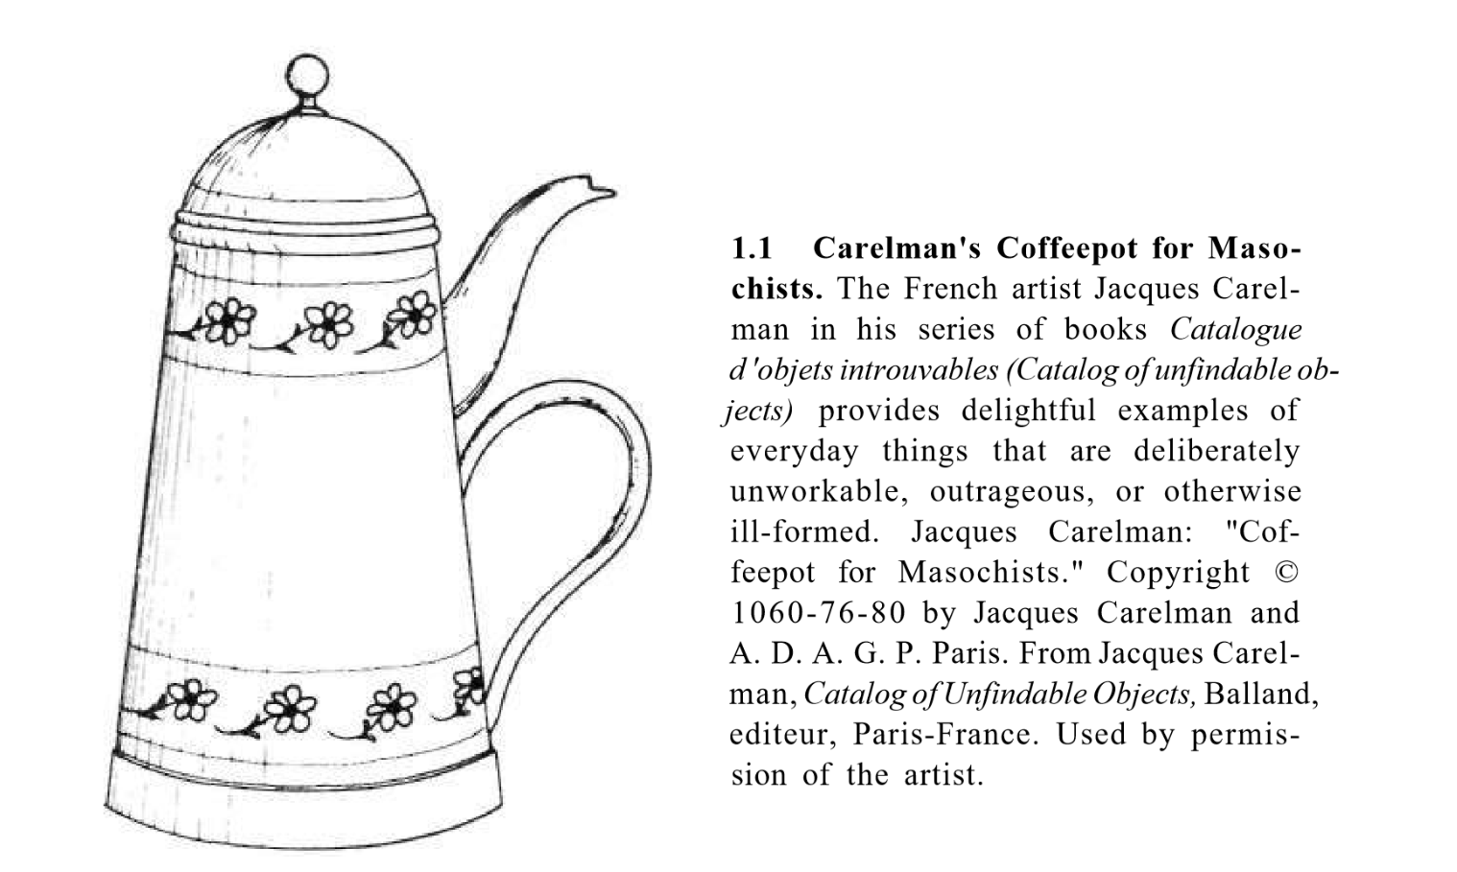
Why do these things exist?

Slide 10
Consequences of poor design
Frustration
Efficiency
Safety Hazards
Cost
Accessibility
Environment
Health Impacts
Societal impacts
Other?

Slide 11
Well-designed vs. Poorly-designed
How do we know whether something is well or poorly designed?
Universality of design?
Examplars of good design?

Slide 12
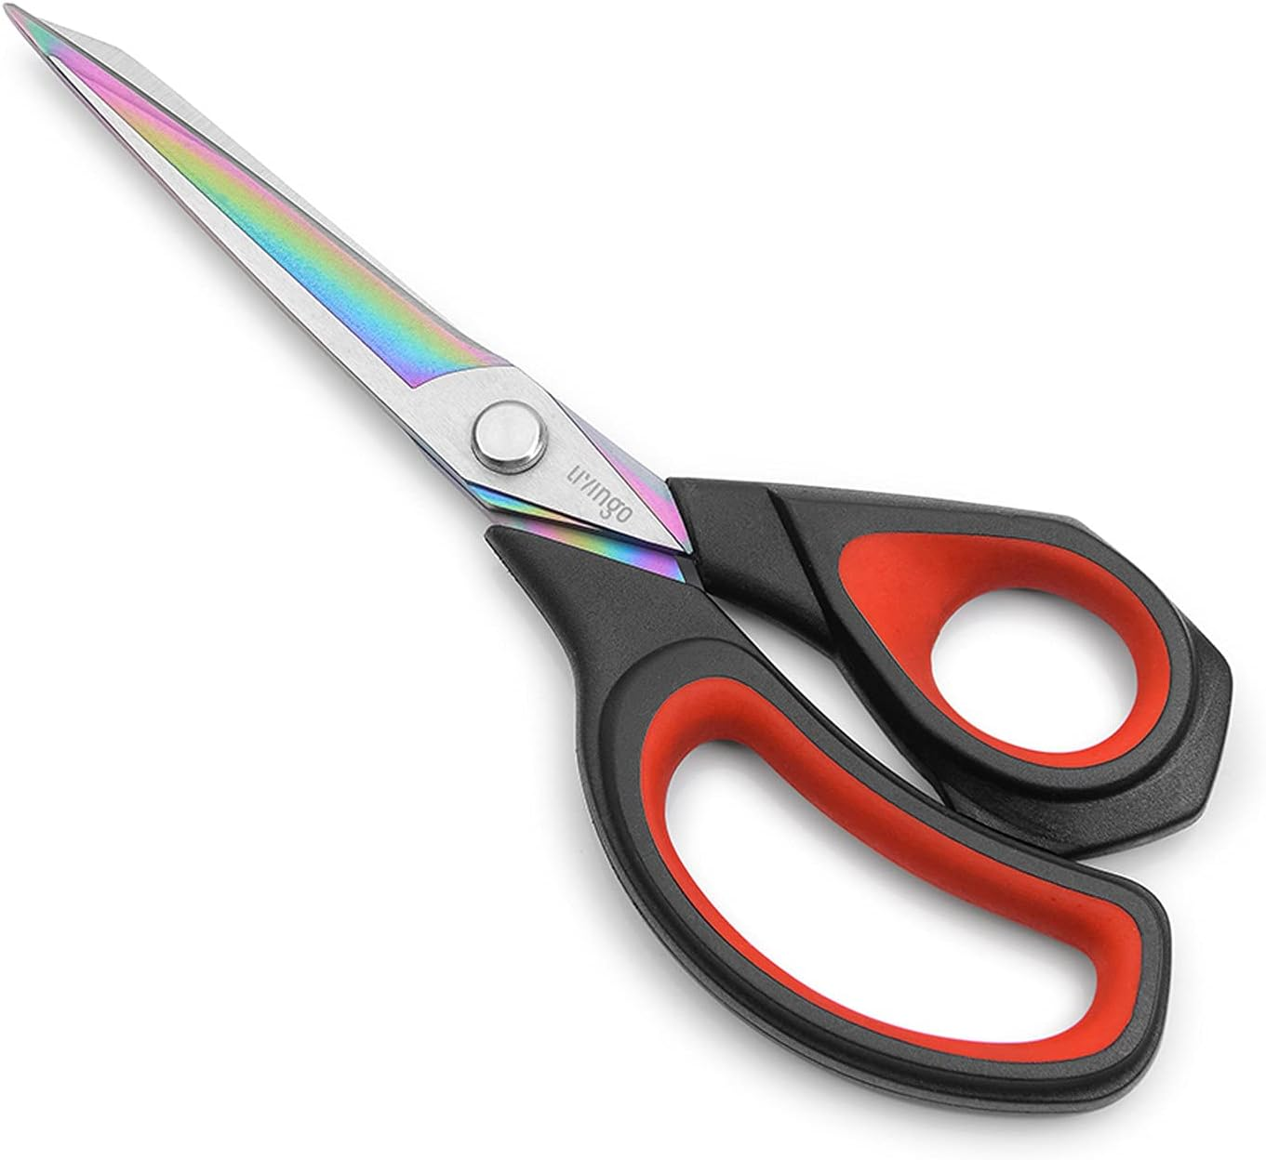
Indications of good design
Visibility
Mappings
Affordances
Refers to the perceived and actual properties of a thing, primarily those fundamental properties that determine just how the thing could be possibly used

Slide 13
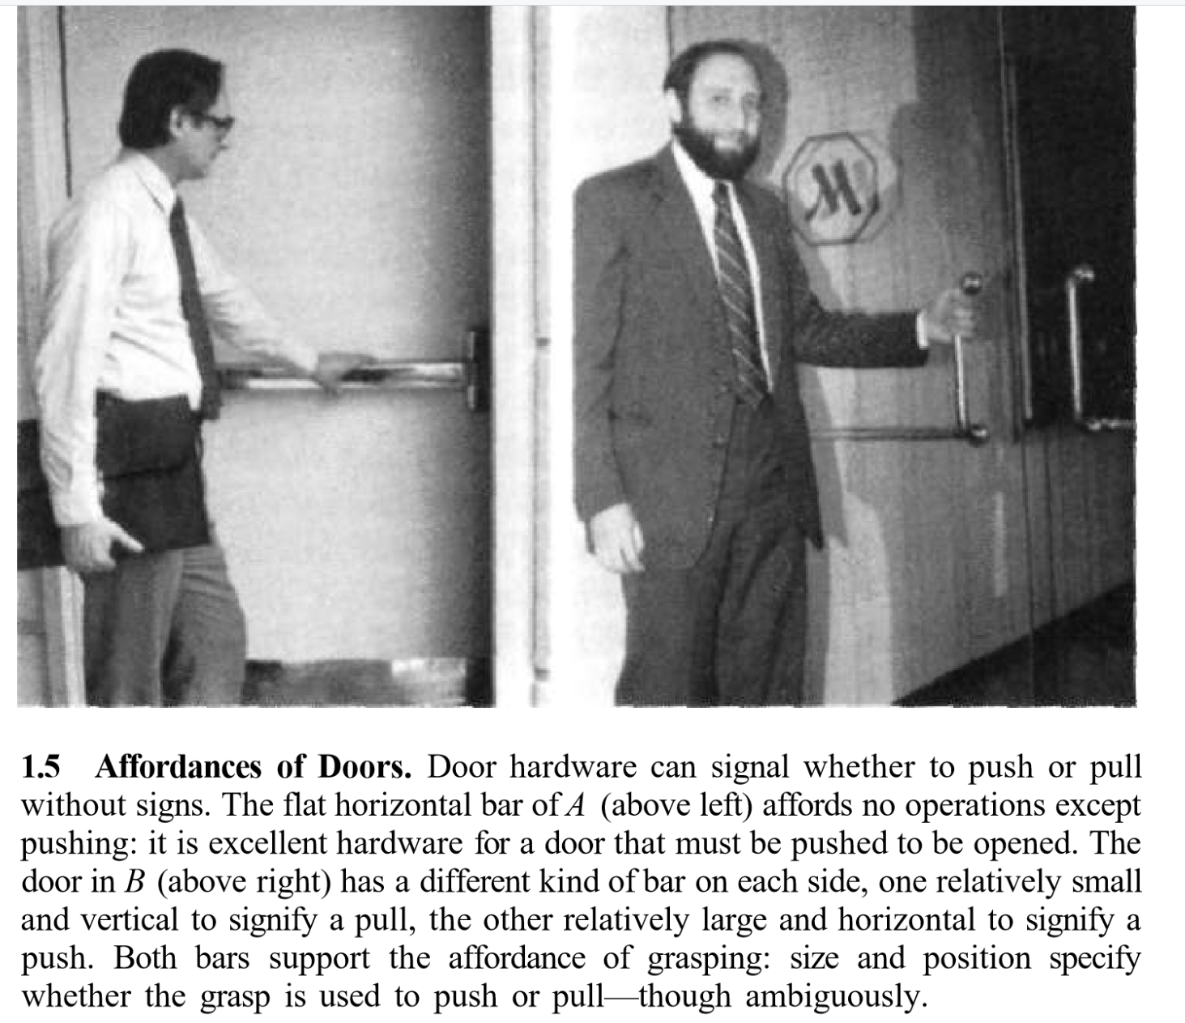

Slide 14
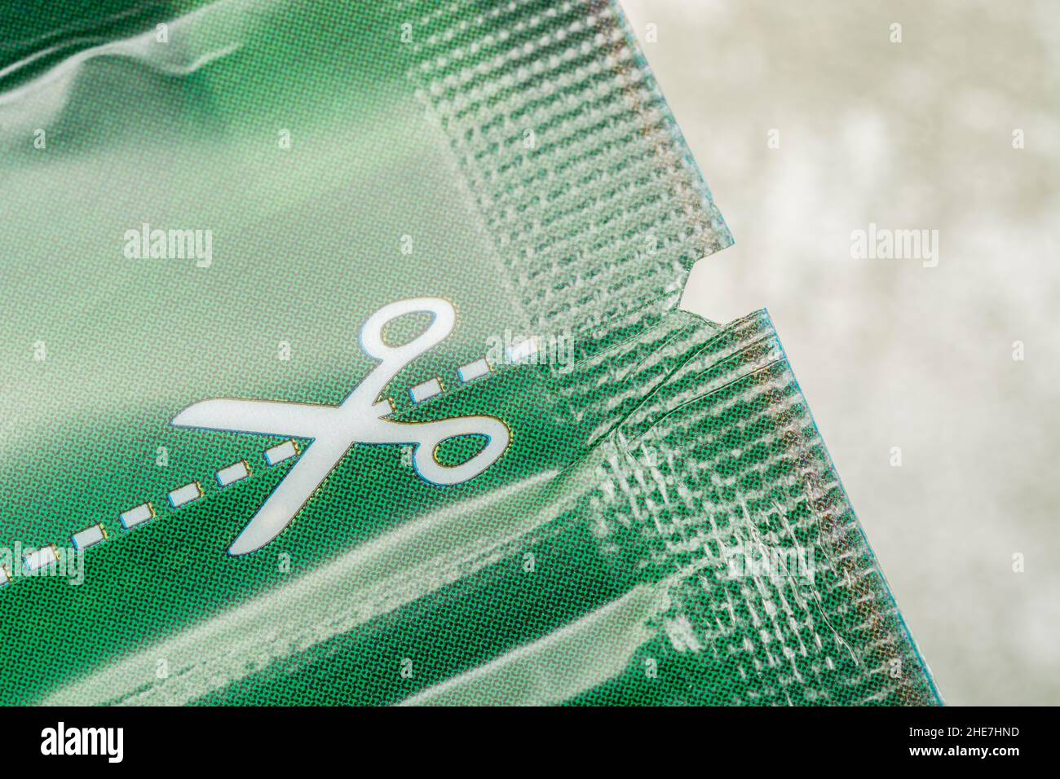
Signifiers
An indicator, often sensory, that signals where an action should take place. It is a sign or a cue that provides guidance about where to perform an action.
Example: A “Push” label on a door

Slide 15
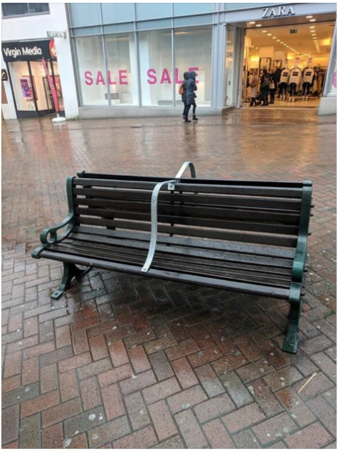
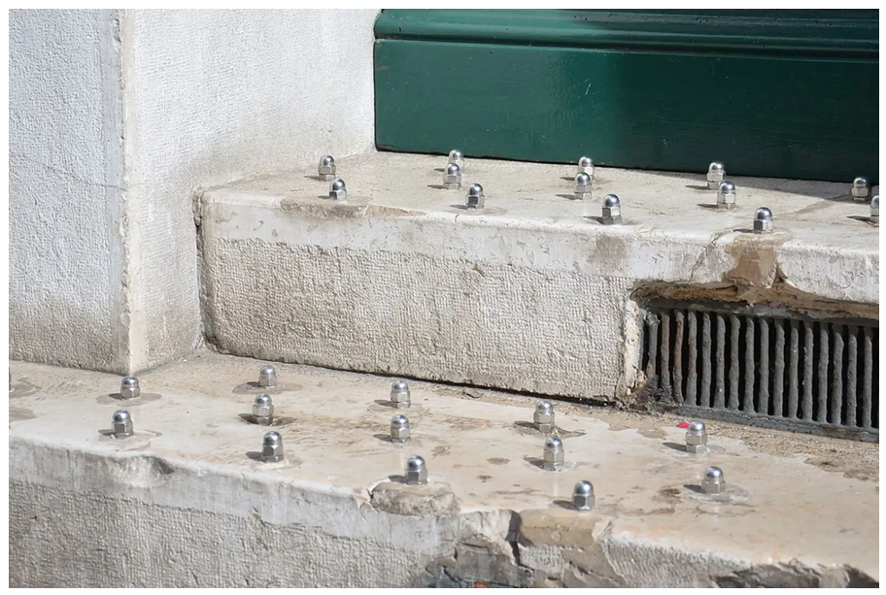
Hostile Design/Architecture

Slide 16
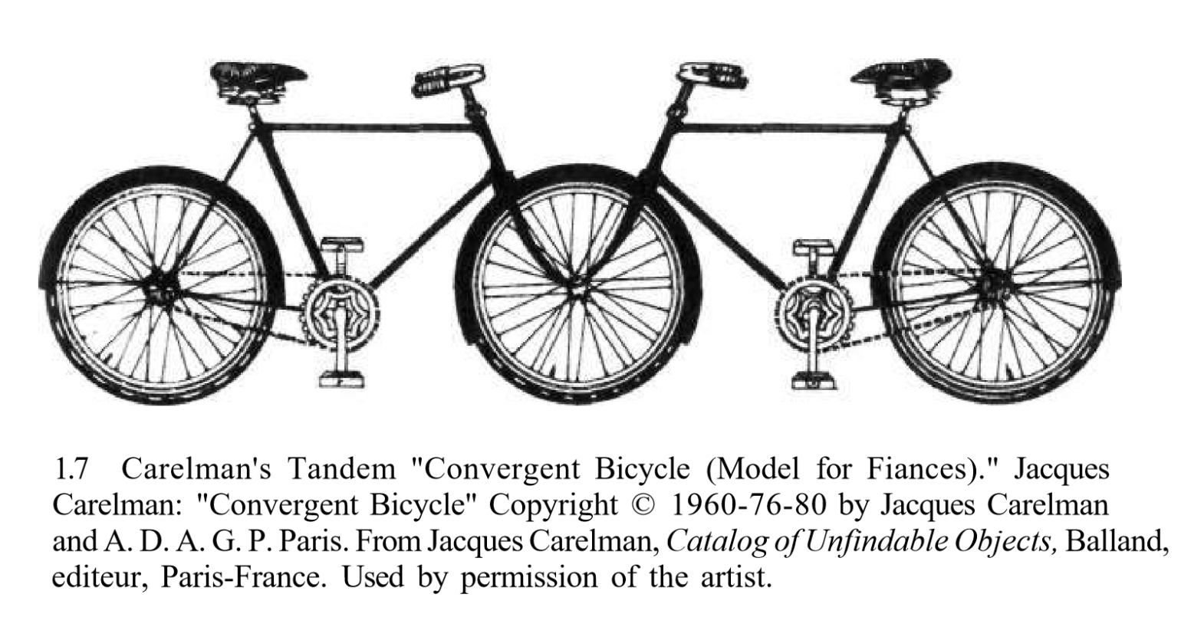
Conceptual Models

Slide 17
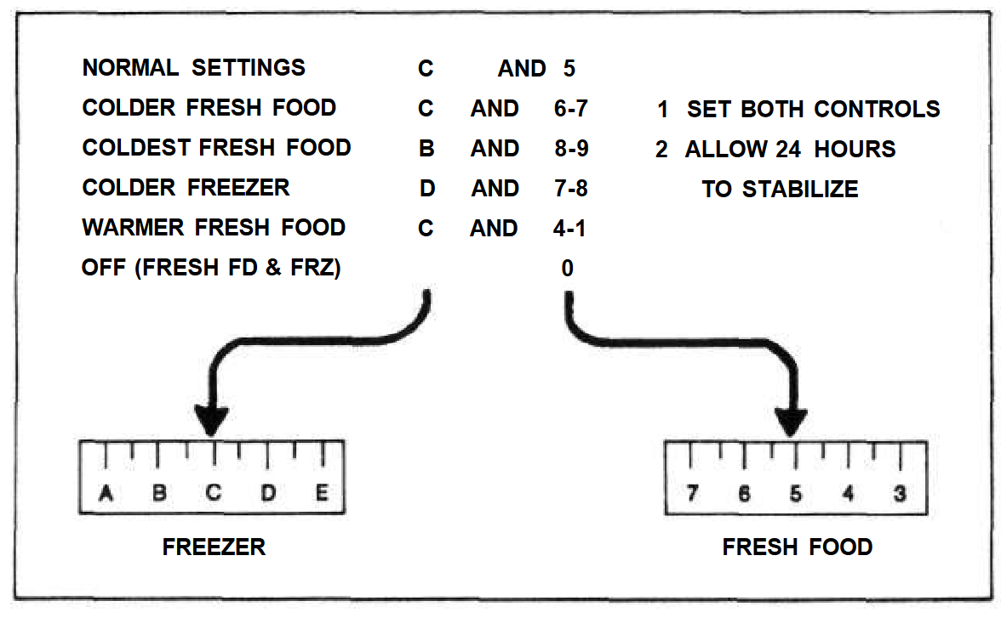
Fridge controls

Slide 18
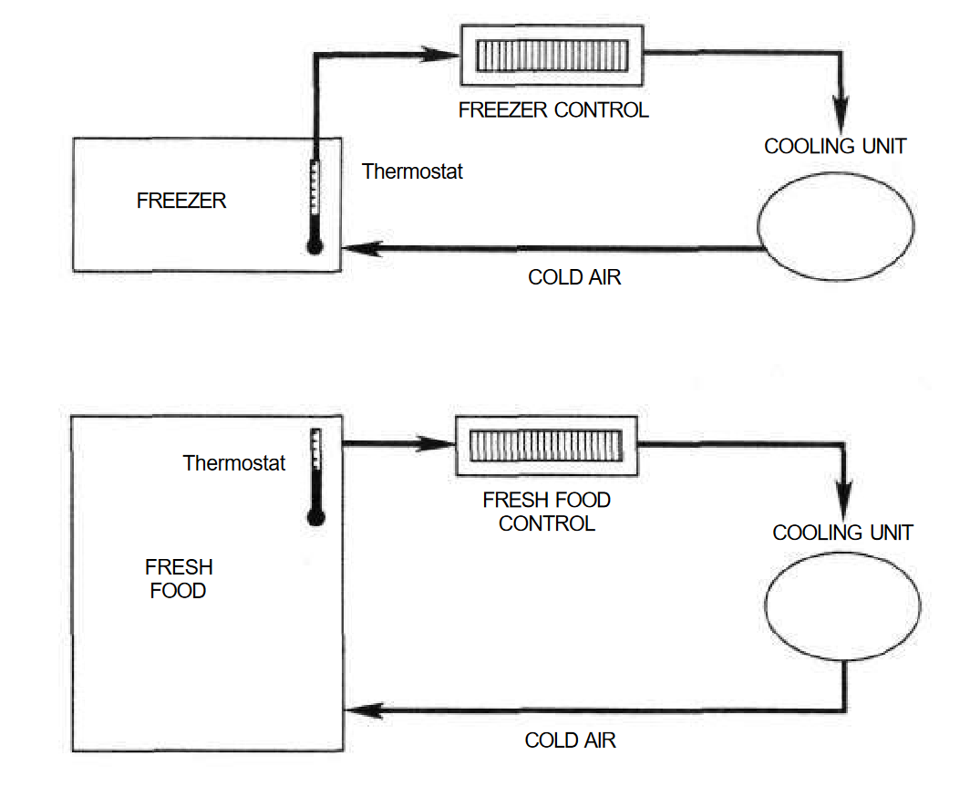
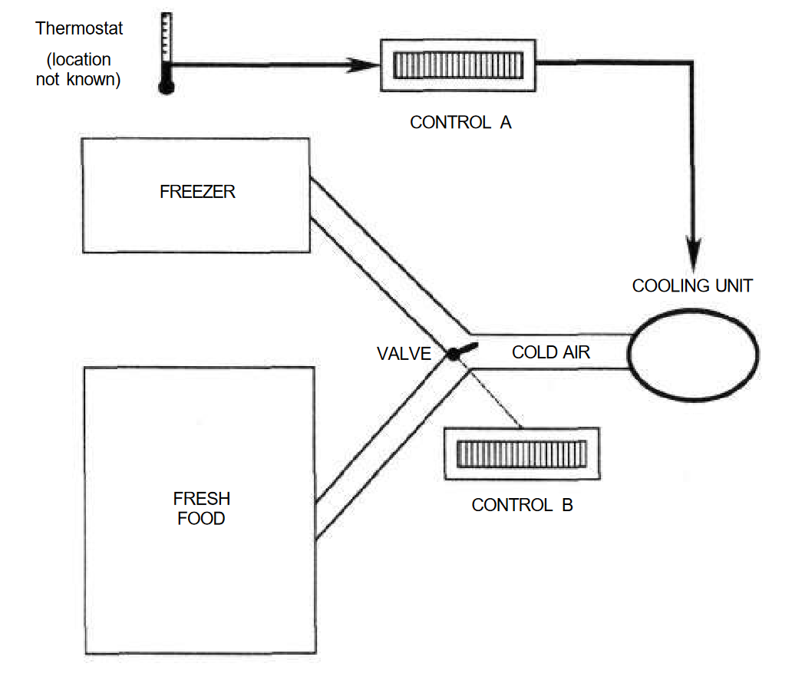
Conceptual Model A Conceptual Model B

Slide 19
Common erroneous conceptual models
Setting thermostat to higher temperature will make it heat the room faster
Car fuel gauges are linear
Crosswalk buttons actually trigger crosswalks
Alkaline batteries should be stored in fridge (was true for NiCd batteries)
Mobile phones cause explosions at gas stations (getting in and out of car generates static electricity)
Other?

Slide 20
Is the purpose of a thing how it is intended to be used or how it is actually used?
Evolution of products and behaviors
Forks vs. cars

Slide 21
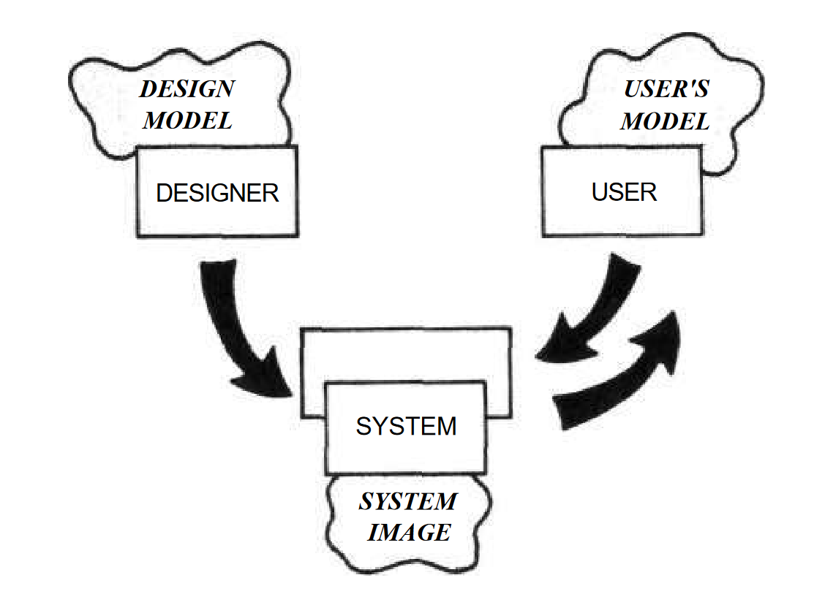
Dealing with Complexity

Slide 22
Mappings

Slide 23
